Slide 1

BDAT1004 DATA PROGRAMING FINAL PROJECT GROUP 7

Slide 2

Content
Meet the Team
Project Overview
Project Scope
Data Source
Tools Used
ETL Process
Data Visualization
Flask Application

Slide 3






Meet the Team
Dakheela Madanayake
Dilini Opita Pathirana
Barsha Tamang
Shih Han Lee
Nikita Tanwar
Project Manager/ Data Analyst
Data Engineer - AWS
Power BI Developer
BI Developer
Power BI Developer

Slide 4




Project Overview

Slide 5
Purpose of the Project
This project serves as a demonstration of our team's capabilities and expertise through a Proof-of-Concept (POC) Data Analysis, showcasing our potential as the ideal choice for the Client project.

Slide 6


Project Summary
Acquired data from a remote source : Kaggle API
Python is used to ETL processes.
AWS is used as the cloud platform to acquire, process and store data along with data orchestration.
AWS Glue job is used to trigger the data pipeline for the weekly pseudo-batch process.
Data Visualization is developed using Power BI dashboard.
Bonus: Developed a Flask application including data visualization using chart.js

Slide 7
Project Scope
AWS Glue Job
A scheduled Glue job to trigger the data pipeline weekly.
AWS Data Pipeline will be activated and start the process.
Retrieve Data
Visualize the Redshift table data using Power BI to gain Sales /Profit insights.
Additionally, Data will be visualized via Flask application.
ETL
Retrieve data via Kaggle API from the data source.
Visualization
Pre-process the data and store in S3 and load processed data to AWS Redshift table.
Activate Pipeline

Slide 8
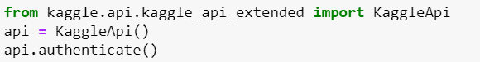
Data Source
URL: https://www.kaggle.com/datasets/vivek468/superstore-dataset-final
The data acquired for the project belongs to Sales & Profits of ‘Superstore’ supermarket.
This data is extracted via Kaggle API.

Slide 9
Tools Used
AWS Cloud Platform – EC2, Redshift, S3, Data Pipeline, Glue, IAM, SSM
Python
Visual Studio Code
PowerBI
Flask Framework
Chart.js

Slide 10
ETL Process

Slide 11
Data Orchestration
The data pipeline that gets activated from weekly scheduled Glue job trigger will create an EC2 instance.
All the database credentials, configuration details are stored in AWS Systems Manager (SSM) Parameter store considering the security aspects.
Once the EC2 is up & running, all the necessary packages, python scripts/ SQL scripts will be copied via a “bootstrap.sh” shell script as the first activity in the pipeline.
Once the bootstrap execution completed, “superstore_load.py” script will start to execute as the second activity in the data pipeline. This will retrieve data via Kaggle API , pre-process and store the pre-processed data in S3 and the data will also be loaded into a staging Redshift table.
As the final activity, “superstore_unload.py” script will be executed transforming data and storing final output data to S3 and target Redshift table.
Finally, data will be visualized via PowerBI dashboard and Flask app that is connected to the target Redshift table as the data source.

Slide 12
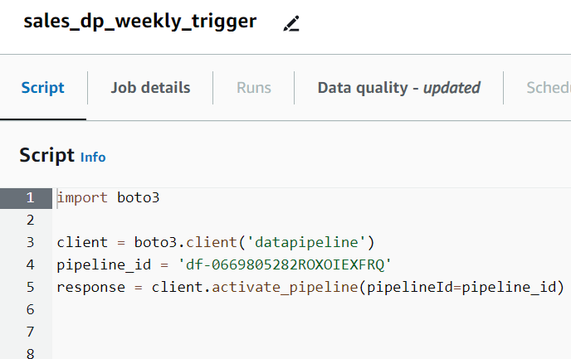
Glue Trigger

Slide 13
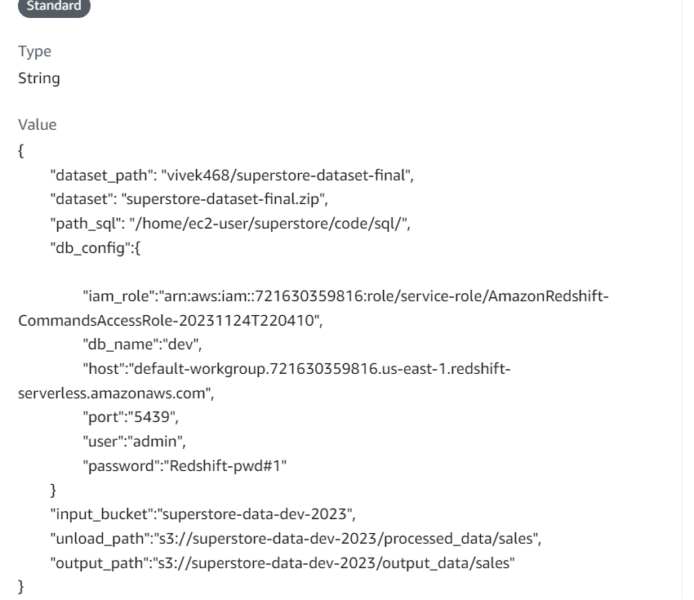
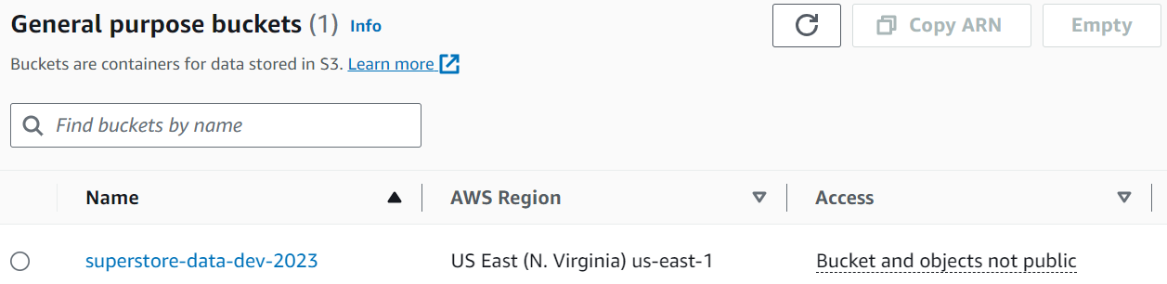
Storage – Scripts & Configurations / Database Credentials
Parameter Store – stored configs & credentials
S3– stored scripts /logs/data

Slide 14
Python / SQL Scripts
Load
Unload
superstore_load.py
sql_stg_sales.ini
superstore_unload.py
sql_tgt_sales.ini
To retrieve data from the data source and load to staging table
To load data from staging table to target table and store output in S3 location once the data transformations are completed.

Slide 15
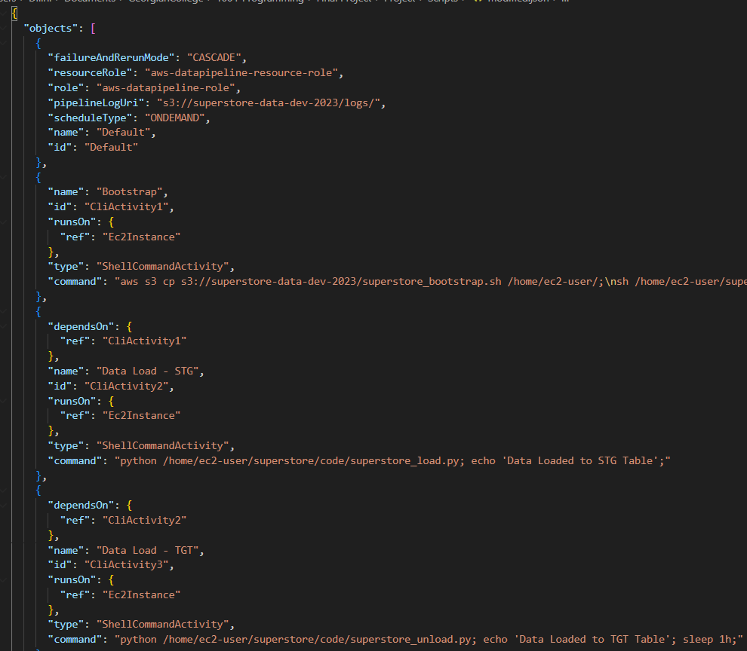
Data Pipeline
“superstore_pipeline.json” is the pipeline definition that is used to create the data pipeline in AWS.

Slide 16
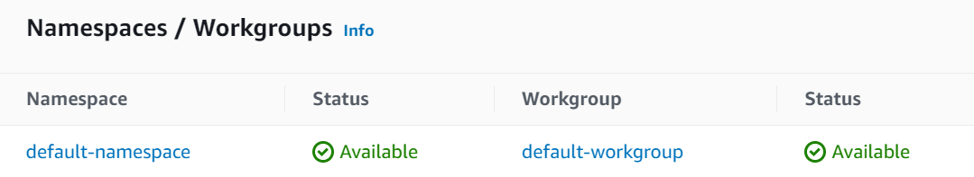
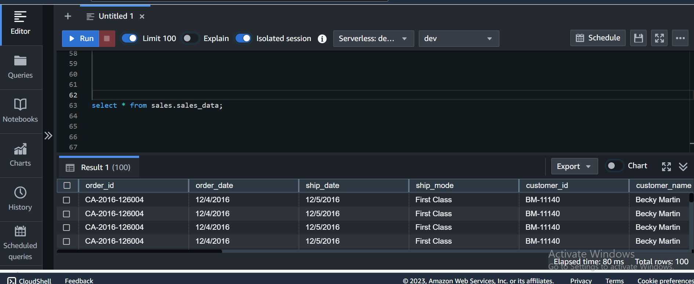
Redshift Cluster
Parameter Store – stored configs & credentials
AWS Redshift Serverless cluster created to store data

Slide 17
Data Visualization

Slide 18
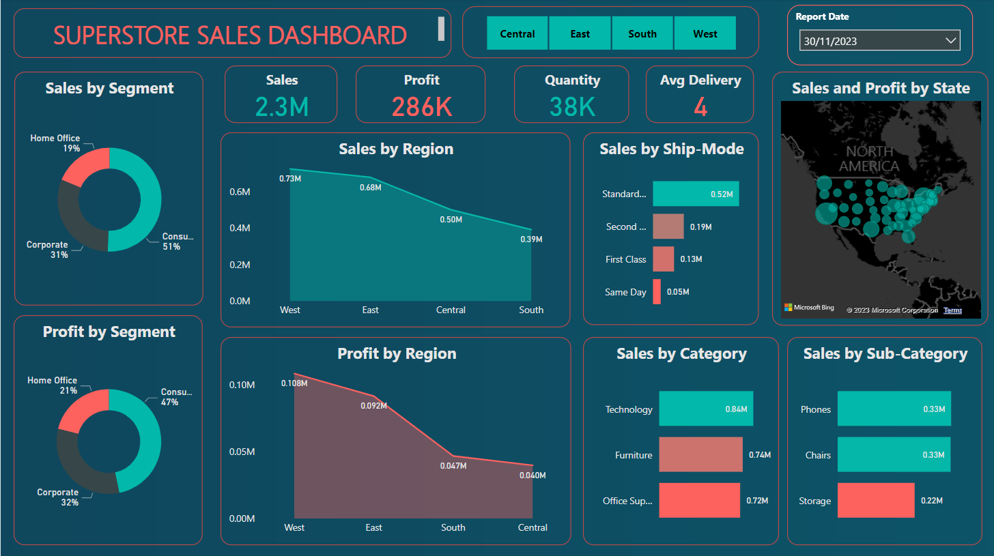
Power BI

Slide 19
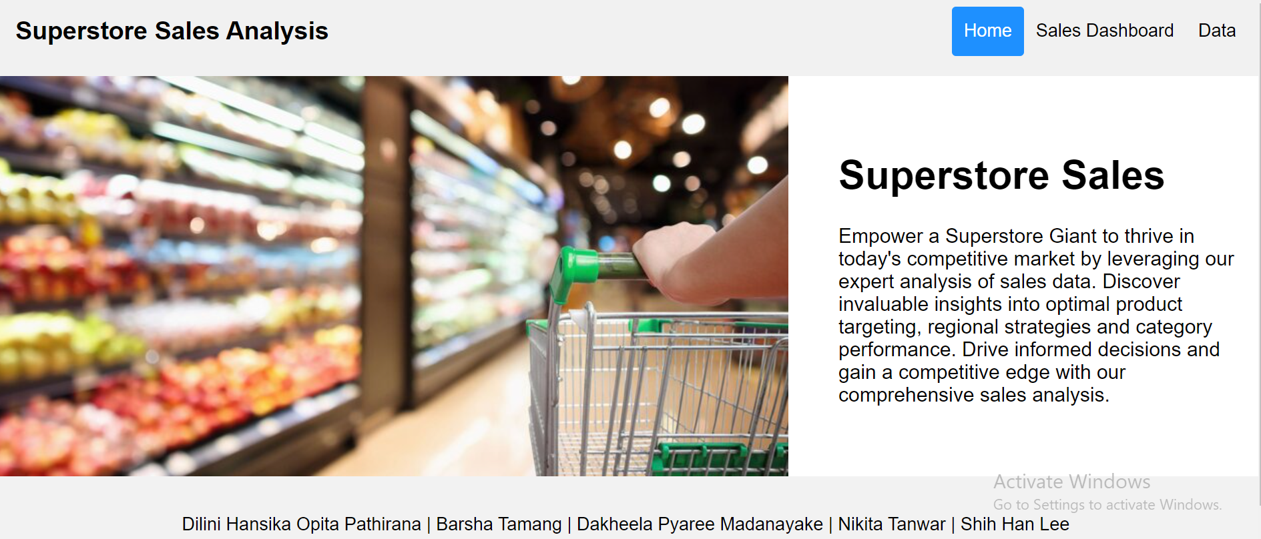
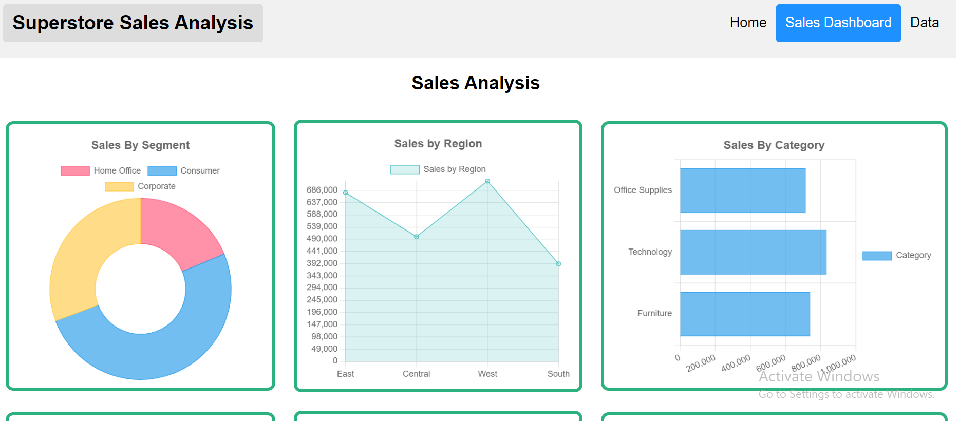
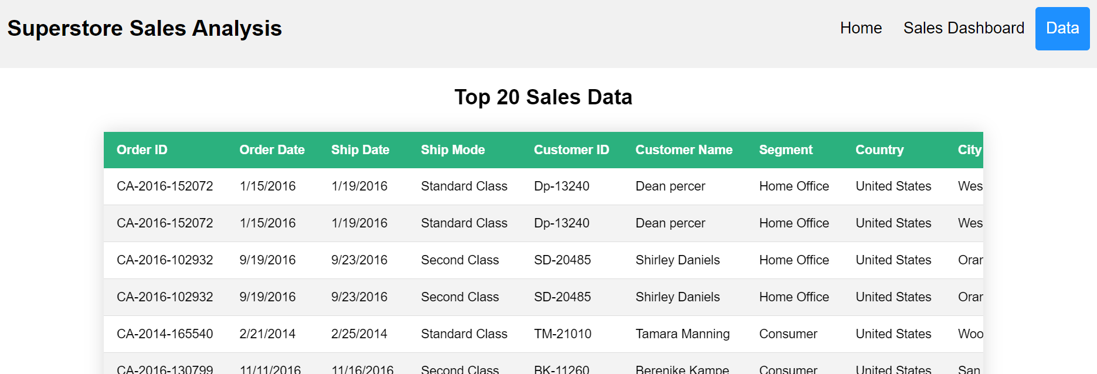
Flask Application - BONUS

Slide 20

Thank You

